Slide 1
Mathematics (9-1) - iGCSE
2018-20
Year 09
Unit 18 – Answers

Slide 2
18 - Prior knowledge check
Page 703
a. 2:3 b. 1:3 c. 2:1
a. LM = $\frac{5}{7}$LX b. MX = $\frac{2}{7}$LX c. LX = $\frac{7}{2}$MX
a. 3$\sqrt{3}$ b. 4$\sqrt{5}$ c. 5$\sqrt{5}$
a. 3x + 5y b. 6x - 9 c. 10a + 4b

Slide 3
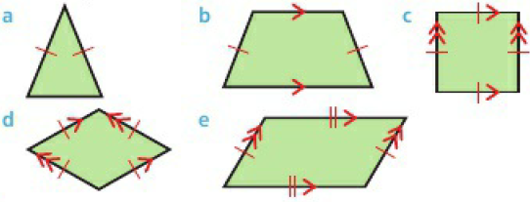
18 - Prior knowledge check
Page 703
7.62 (3 s.f.)

Slide 4
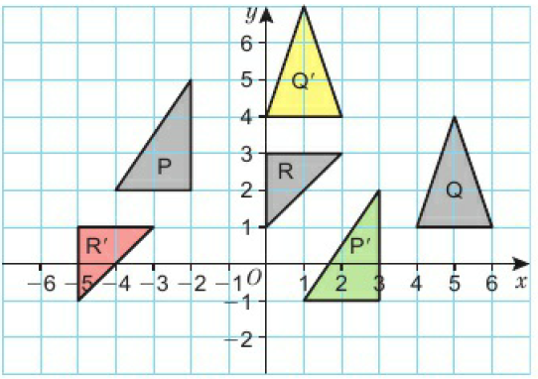
18 - Prior knowledge check
Page 703
a. 9.59⁰ b. 9.59⁰

Slide 5
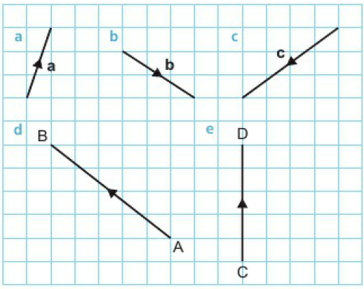
18.1 – Vectors and Vector Notation
Page 703
a. (${6 \atop −2}$) b. (${4 \atop −2}$) c. (${−3 \atop −5}$)
2$\sqrt{13}$

Slide 6
18.1 – Vectors and Vector Notation
Page 703
a. (${2 \atop 2}$) b. (${2 \atop −5}$) c. (${4 \atop −3}$)
a and d
6.40
a. 10 b. 13 c. $\sqrt{10}$ d. 17 e. 2$\sqrt{13}$

Slide 7
18.1 – Vectors and Vector Notation
Page 703
a. AB = 25 b. AC = 25, as AB = AC = 25 triangle ABC is isosceles.
a. (${−6 \atop −4}$) b. 2$\sqrt{13}$ or 7.21
(-1, -1)

Slide 8
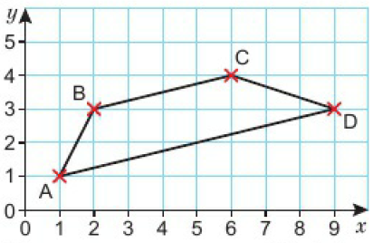
18.2 – Vector Arithmetic
Page 703
a. (${2 \atop 1}$) b. (${−2 \atop −1}$)
(${−3 \atop 2}$)
a. b. (${8 \atop 2}$) c. Trapezium d. $\vec{AD}$ = $\vec{2BC}$

Slide 9
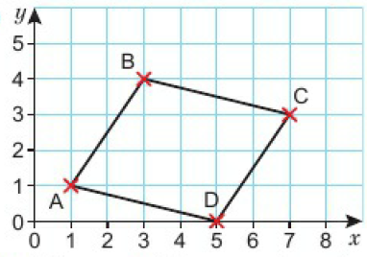
18.2 – Vector Arithmetic
Page 703
a. b. i. (${−4 \atop 1}$) ii. (${−2 \atop −1}$) $\vec{BC}$ = -$\vec{CB}$ c. i. $\vec{AB}$ = $\vec{DC}$ ii. $\vec{AD}$ = -$\vec{CB}$

Slide 10
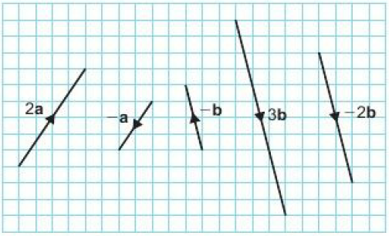
18.2 – Vector Arithmetic
Page 703
Parallelogram
a. ($2, 6$) b. (${2 \atop 1}$) c. 2$\sqrt{5}$

Slide 11
18.2 – Vector Arithmetic
Page 704
a. (${4 \atop 2}$) b. (${6 \atop 3}$) c. (${−8 \atop −4}$) d. (${1 \atop 0.5}$)
(${4 \atop 3}$)

Slide 12
18.2 – Vector Arithmetic
Page 704
a. Students’ drawings b. (${8 \atop 1}$)
a. (${9 \atop 2}$) b. (${1 \atop −1}$)
a. i. (${−2 \atop 6}$) ii. (${−2 \atop 6}$) b. i. (${0 \atop 0}$) ii. (${0 \atop 0}$)
(${4 \atop 4}$)
a. (${−2 \atop −4}$) b. (${−1 \atop 11}$) c. (${−1 \atop 8}$) d. (${3 \atop −3}$) e. (${−2 \atop 10}$)
Students’ own answers.

Slide 13
18.3 – More Vector Arithmetic
Page 704
a. (${6 \atop 1}$) b. 6.1
(${2 \atop 6}$)
a. (${−1 \atop 4}$) b. $\vec{DB}$ = $\vec{AC}$ = (${3 \atop −1}$)
a. $\sqrt{106}$ b. 6$\sqrt{2}$ c. 4$\sqrt{2}$ d. 2$\sqrt{10}$
a. a + b b. a + b + c

Slide 14
18.3 – More Vector Arithmetic
Page 704
a. $\frac{1}{2}$a b. i. (${−6 \atop −4}$) ii. (${3 \atop 2}$)
a. 2b b. a + b c. a + 2b
a. SR is parallel to PQ so $\vec{SR}$ = $\vec{PQ}$ = a b. i. p + q ii. a + b
a. i. b ii. q – p b. $\frac{1}{2}$(p + q)

Slide 15
18.3 – More Vector Arithmetic
Page 704
a. b - a b. S is the midpoint of PR
a. ED is parallel to and equal to AB, so $\vec{ED}$ = $\vec{AB}$ = n b. i. m ii. p c. i. n + m ii. n + m + p d. n + m
a. r b. –s c. $\frac{1}{2}$r d. s + $\frac{1}{2}$r

Slide 16
18.3 – More Vector Arithmetic
Page 704
a. $\vec{ED}$, $\vec{AB}$ and $\vec{IJ}$ b. i. 3p – 3q ii. 6a - 6$\frac{1}{2}$b
a. b - a b. $\frac{1}{2}$(b – a) c. $\frac{1}{2}$(a + b)
a. b - a b. $\frac{1}{2}$a c. $\frac{1}{2}$b d. $\frac{1}{2}$(b – a)

Slide 17
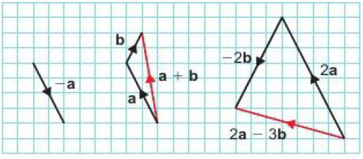
18.4 – Parallel Vectors & Collinear Points
Page 704
a. (${−2 \atop 3}$) b. (${2 \atop 1}$) c. (${0 \atop 0}$)
(${−1 \atop 1}$)

Slide 18
18.4 – Parallel Vectors & Collinear Points
Page 704
(${−1 \atop 1}$)
(${0.5 \atop −0.5}$)
(${11 \atop −2}$)
a. (${1 \atop 5}$) b. (${−1 \atop −5}$) c. (${2 \atop 4}$) d. (${1 \atop −1}$)
b - a

Slide 19
18.4 – Parallel Vectors & Collinear Points
Page 704
a. $\vec{OP}$ = (${−2 \atop 5}$); $\vec{OQ}$ = (${3 \atop 1}$)
i. (${5 \atop −4}$) ii. (${20 \atop −16}$)
(${20 \atop −16}$) = 4(${5 \atop −4}$) so RS is parallel to PQ and is 4 times the length.
a. (${−10 \atop −4}$) b. (${18 \atop 12}$) c. (16, 8)

Slide 20
18.4 – Parallel Vectors & Collinear Points
Page 704
(${2 \atop −3}$)
a. $\vec{AB}$ = 2b, so $\vec{OC}$ is parallel to $\vec{AB}$ and the same length,
$\vec{BC}$ = -a, so $\vec{BC}$ is parallel to, and the same length as, $\vec{OA}$ but the opposite direction,
Parallelogram

Slide 21
18.4 – Parallel Vectors & Collinear Points
Page 704
a. i. (${3 \atop 9}$) ii. (${9 \atop 27}$)
$\vec{AC}$ = 3 x $\vec{AB}$ as (${9 \atop 27}$) = 3 (${3 \atop 9}$) so the lines are parallel. Both lines pass trough point A so A, B and C are collinear.
$\vec{PQ}$ = (${3 \atop 3}$), $\vec{QR}$ = (${6 \atop 6}$) = 2(${3 \atop 3}$) so the lines are parallel. Both lines pass through point Q so P, Q, and R are collinear.
Students’ own answers.

Slide 22
18.5 – Solving Geometric Problems
Page 704
2p and 5p; p - q and 4q - 4p; 3q - p and 2p - 6q
a. $\vec{PR}$ = 9a - 6b = 3(3a - 2b) so PR is parallel to PQ and is 3 times its length, b. P, Q and R are collinear.
a. i. a ii. b iii. –a iv. –b b. 2b – 2a c. b – a d. AB is parallel to MN and equal to twice its length.

Slide 23
18.5 – Solving Geometric Problems
Page 704
a. $\frac{1}{3}$(b – a) b. $\frac{1}{3}$(b + 2a)
a. b – a b. $\frac{1}{2}$(b - a) c. $\frac{1}{2}$(b + a)
a. 2a + 2b b. 7a + 6b
a. i. 6b – 6a ii. 6a b. 12b – 3a
$\vec{EF}$ = $\frac{3}{4}\text{(}\text{b} \text{− }\text{a}\text{)}$; $\vec{AB}$ = $\text{b} \text{− }\text{a}$; $\vec{EF}$ is a multiple of $\vec{AB}$, therefor the lines are parallel.

Slide 24
18.5 – Solving Geometric Problems
Page 704
a. i. $\frac{1}{2}$(m + n) ii. $\frac{3}{4}$(m + n) iii. $\frac{3}{4}$n - $\frac{1}{4}$m b. i. $3$n – m c. $\vec{MQ}$ = $\frac{3}{4}$n - $\frac{1}{4}$m = $\frac{1}{4}$(3n – m). $\vec{MQ}$ is a multiple of $\vec{MR}$, therefor the lines are parallel, Both lines pass through point M, so MQR is a straight line. $\frac{MR}{MQ}$ = 4

Slide 25
18.5 – Solving Geometric Problems
Page 705
a. 2b b. 2a + b c. 4a + 2b
$\vec{OS}$ = $\frac{1}{2}$(4a + 2b) = so S is the midpoint of OT.
$\vec{QR}$ = 3a – 2b = (${18 \atop −24}$). QR is 30

Slide 26
18 – Problem Solving
Page 705
a. b - a
i. $\frac{1}{4}$a ii. $\frac{1}{4}$b iii. $\frac{1}{4}$(b – a)
AB and XY are parallel as one is a multiple of the other. AB is four times the length of XY.
Anna is correct (AB, AC, AD, BA, BC, BD, CA, CB, CD, DA, DB, DC)

Slide 27
18 – Problem Solving
Page 705
The data gives the graph y = -0.01 +18, which shows the temperature at 2500m is -7°C
The spaniel walker takes 6.75 minutes; the Labrador walker takes 5.88 minutes. The Labrador makes it to the opposite corner of the park first.
Alexandra is correct: 0.496 x 2.6³ = 8.7176, i.e. 8 litres 718ml (to the nearest ml)

Slide 28
18 – Problem Solving
Page 705
Anthony earns the biggest annual salary. Ross earns £28000 and Antony earns £30000.
$\frac{15 x 18000}{620}$ = 10800, so x = 24.8. Hence the owner must employ at least 25 apple pickers.

Slide 29
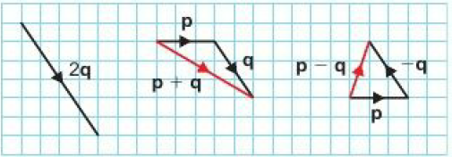
18 – Check Up
Page 705
a. (${2 \atop 3}$) b. (${3 \atop −1}$)
a. (3, 7) b. (${3 \atop −5}$)
$\sqrt{34}$

Slide 30
18 – Check Up
Page 705
(${−2 \atop 3}$)
a. (${3 \atop 4}$) b. (${−5 \atop 8}$) c. (${12 \atop −6}$)
(${2 \atop −1}$)
a. 3a – 3b; $\frac{1}{2}$a - $\frac{1}{2}$b b. 3a + 3b
a. (${4 \atop −3}$) b. (${−2 \atop 7}$) c. (${−6 \atop 0}$)

Slide 31
18 – Check Up
Page 705
a. i. (${3 \atop 9}$) ii. (${9 \atop 27}$)
$\vec{AC}$ = 3(${3 \atop 9}$) so A, B and C are collinear.
a. i. $\frac{1}{2}$a ii. $\frac{1}{2}$a - $\frac{1}{2}$c
$\vec{CA}$ is a multiple of $\vec{MN}$ so the lines are parallel.

Slide 32
18 – Check Up
Page 705
From Pythagoras' theorem: $\sqrt{p2+q2}$ = $\sqrt{p2+\left(−q\right)2}$

Slide 33
18 – Strengthen
Page 705
a. (${2 \atop 2}$) b. (${−2 \atop −2}$) c. (${−6 \atop 3}$) d. (${−5 \atop −2}$)
a. (${4 \atop 6}$) b. $\vec{OB}$ = (${8 \atop 2}$)
(3, 8)
(${3 \atop −1}$)

Slide 34
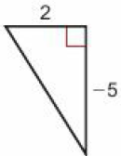
18 – Strengthen
Page 705
a. b. $\sqrt{29}$
a. 5 b. $\sqrt{106}$ c. $\sqrt{130}$ d. $\sqrt{34}$

Slide 35
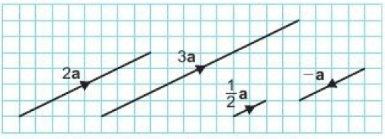
18 – Strengthen
Page 705
Vector Arithmetic

Slide 36
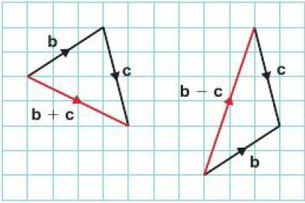
18 – Strengthen
Page 705

Slide 37
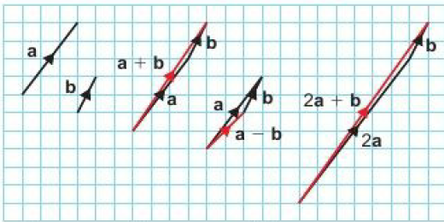
18 – Strengthen
Page 705
a. b. i. (${4 \atop 6}$) ii. (${2 \atop 2}$) iii. (${7 \atop 10}$) c. i. (${4 \atop 6}$) ii. (${2 \atop 2}$) iii. (${7 \atop 10}$)

Slide 38
18 – Strengthen
Page 705
a. (${5 \atop 8}$) b. (${6 \atop −10}$) c. (${10 \atop 16}$) d. (${12 \atop −6}$)
a. (${6 \atop 3}$) b. (${9 \atop −4}$) c. (${−1 \atop 11}$)
(${3 \atop 10}$)

Slide 39
18 – Strengthen
Page 705
Geometric Problems
Parallel lines of the same length have the same column vector.
a + b; 2(a + b); 3a + 3b; 2a + 2b
(${4 \atop 6}$), (${2 \atop 3}$), (${−4 \atop −6}$), (${8 \atop 12}$)
a. $\vec{CD}$ is a multiple of $\vec{AB}$ b. $\vec{CD}$ = 2$\vec{AB}$ = 2a c. $\vec{BC}$ = $\vec{BA}$ + $\vec{AD}$ + $\vec{DC}$ = -a + b + 2a = b + a

Slide 40
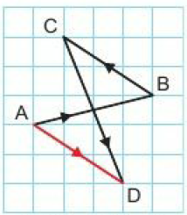
18 – Strengthen
Page 705
a. b. (${3 \atop −2}$)
$\vec{AC}$ = (${3 \atop 1}$) + (${−3 \atop 2}$) = (${1 \atop 3}$); $\vec{DB}$ = (${−2 \atop 5}$) + (${3 \atop −2}$) = (${1 \atop 3}$) AC is parallel to DB and they are equal in length

Slide 41
18 – Strengthen
Page 706
a. (${6 \atop 3}$) b. (${4 \atop 2}$)
$\vec{AB}$ = 3(${2 \atop 1}$) and $\vec{BC}$ = 2(${2 \atop 1}$). Both are multiples of the same vector and so are parallel. They both pass through B, so they are collinear.
a. (${3 \atop −2}$) b. (${5 \atop −1}$) c. (${2 \atop 1}$)
a. $\vec{AB}$ = (${4 \atop 3}$); $\vec{BC}$ = (${12 \atop 9}$)
$\vec{BC}$ = (${12 \atop 9}$) = 3(${4 \atop 3}$). Both are multiples of the same vector and so are parallel.
$\vec{AB}$ and $\vec{BC}$ are parallel and both pass through point B, So ABC is a straight line and A, B, and C are collinear.

Slide 42
18 – Strengthen
Page 706
a. $\frac{1}{2}$a b. a – b c. $\frac{1}{2}$(a – b) d. $\frac{1}{2}$(a + b) e. $\frac{1}{2}$b
$\vec{OB}$ and $\vec{CD}$ are both are multiples of b, so are parallel.
a. AP = $\frac{3}{5}$AB; BP - $\frac{2}{5}$BA b. i. b – a ii. $\frac{3}{5}$(b - a) iii. a – b iv. $\frac{2}{5}$(b - a) v. $\frac{2}{5}$a + $\frac{3}{5}$b

Slide 43
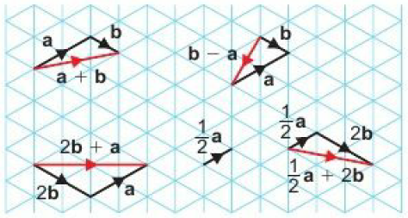
18 – Extend
Page 706
a. 2b b. 2a c. b d. -a e. b - a f. b - a g. a - b h. b + a

Slide 44
18 – Extend
Page 706
a. (4, 5) b. (${−3 \atop −4}$) c. (5, 0)
a. (${4 \atop −1}$) b. (${2 \atop 5}$) c. $\sqrt{29}$
a. b – a b. $\frac{1}{2}$(a + 2b)
a. 2a b. $\frac{1}{2}$(3a + c) c. a + c d. $\frac{1}{5}$(4a + 5c)

Slide 45
18 – Extend
Page 706
a. i. 2j ii. j – k iii. –k - j b. i. j – k ii. $\vec{JX}$ = $\vec{KJ}$, and point j is common.
a. a – 3b
$\vec{NM}$ = $\frac{1}{2}$(a - b), $\vec{NC}$ = (a - b); $\vec{NC}$ is a multiple of $\vec{NM}$ and point B is common, so NMC is a straight line.
a. 3q – 2p
$\vec{OR}$ = $\frac{6}{5}$(p + q); $\vec{OR}$ is a multiple of p + q and so is parallel to p + q

Slide 46
18 – Extend
Page 706
a. a – b b. - $\frac{1}{5}$(3a + 2b)
a. i. 2q – 4p ii. 3(q - p) iii. 2(q - p)
$\vec{AB}$ and $\vec{AC}$ are multiples of q – p. Point A is common, so ABC is a straight line.
9cm

Slide 47
18 – Extend
Page 706
a. b – a b. 2b – a
a. 6b – 3a
$\vec{AB}$ = $\frac{1}{3}\vec{AB}$ = 2b – a $\vec{OX}$ = $\vec{OA}$ + $\vec{AX}$ = 2(b + a) $\vec{OY}$ = $\vec{OB}$ + $\vec{BY}$ = 5(b + a) So $\vec{OX}$ = $\frac{2}{5}\vec{OY}$

Slide 48
18 – Unit Test
Page 706
Sample student answer
The answer should say $\vec{AB}$ = 2n - 2m = 2(n – m) and $\vec{MN}$ = n - m. The student has forgotten the direction of the vectors.
The answer could be improved by adding a sentence at the end, e.g. 'This means AB is parallel to MN and is twice the length.'

Slide 49
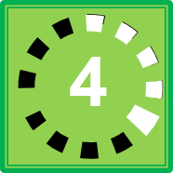
Warm Up
∪ ∩
Reflect
14 – Exam-Style Questions
∞ ∝
Sophie is making Christmas cards. She needs a card and an envelope for each card.
How many packs of cards and envelopes did she buy? (3 marks)
$$\frac{1}{2}$$
$$\frac{□}{□}$$
$\overline{x}$. $\overline{y}$ ξ
(${2 \atop 1}$) ($\frac{4}{7}$)
≈ є ϵ $θ$ µ
∠ π $\vec{CD}$
± $\sqrt{16}$
①
②
③
④
ActiveLearn - Homework, practice and support: Higher 3.1
$$\sqrt[1]{\begin{aligned}3 \\ 4\end{aligned}}$$
$$\sqrt[1]{67}$$
1̇
£
≠ ÷ ≡
Q3 hint - The symbol ± shows that.
4͘͘
$$\sqrt[3]{\frac{3V}{4p}}$$
Key Point 1
4
When there are m ways of doing one task and n
$$\sqrt{\frac{A}{\text{π}}}$$
Q5 communication hint - Inclusive means that the end numbers
Q9f strategy hint - The symbol
X
-5 -4 -3 -2 -1 0 1 2 3 4 5
Age, a (x) | Male | Female
20 ≥ x ≤ 25 | 1 | 0
squared
$\frac{\sqrt{6}}{2}$ $\frac{2}{\sqrt{3}}$
Exam hint
Show a separate
Number | 1 | 2 | 3 | 4 | 5
Frequency | 46 | 39 | 37 | 40 | 38
1 | 6 | 7 | 9 | 9
2 | 1 | 2 | 2 | 4 | 6 | 7 | 8
3 | 3 | 6 | 6 | 7 | 8 | 9 | 9
4 | 0 | 0 | 1 | 3 | 4 | 5 | 8 | 8 | 9 | 9
5 | 0 | 1 | 2 | 4 | 4 | 5 | 6 | 7 | 9

